Slide 1
Project 0: TODO App
CS50M: Mobile App Development with React Native
Submission by Krishna Sri Somepalli

Slide 2
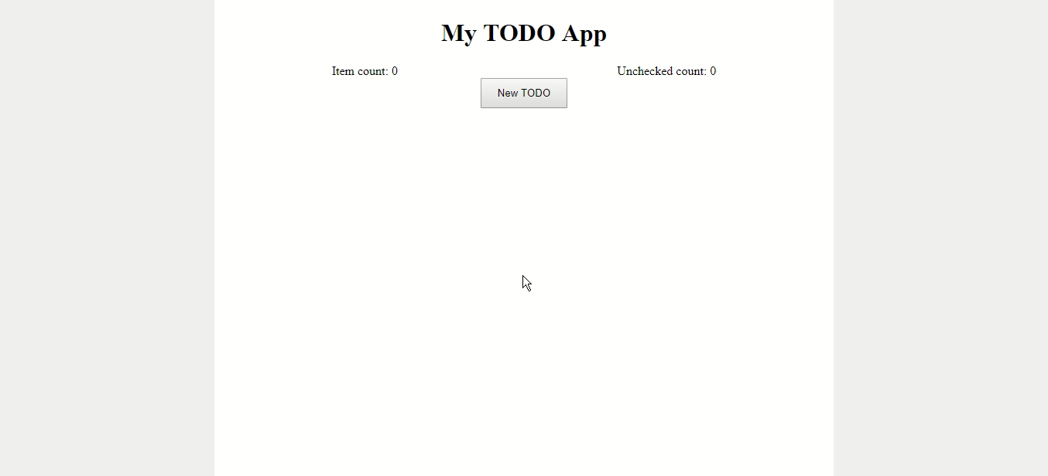

Slide 3
Thank you! :)

